Slide 1
MAVEN

Slide 2
Course Objective
To understand and execute Maven build tool
- Maven Overview
- POM

Slide 3
Session Objective
Maven Introduction
Why Maven
Maven Architecture
POM
Maven build life cycle
Maven Plugins

Slide 4
Reference Link
Web Link
https://maven.apache.org

Slide 5
MAVEN Overview

Slide 6

Maven - Introduction
Maven is a build tool:
- It always produce an one artifact(Component) - like war,jar or zip etc.
- It helps to manage dependencies.
Also project management tool:
- It handles versioning and releases
- Describes what your project is doing or what it produces
- can easily produce javadocs as well as other site information.
Maven is managed by apache Software foundation.
Maven sites are build with Maven
Open source

Slide 7

Why Maven ?
Repeatable builds
-We can recreate our build for any environment.
Transitive dependencies
Downloading dependency will also pull their other items it needs.
Contains everything it needs for your environment
Works with local repo
Works with your IDE, but also standalone

Slide 8
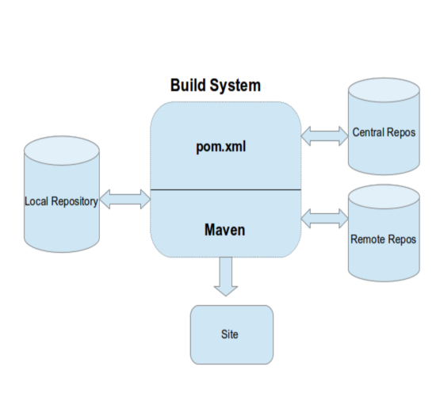
Maven - Architecture
Every Maven project contains a POM file that defines the project essentials. Maven uses the POM details to decide upon different actions and artifact generation. The dependencies specified are first searched for in the local repository and then in the central repository and later in Remote repository.

Slide 9
POM
A Project Object Model (POM) provides all the configuration for a single project.
General configuration covers the project's name, its owner and its dependencies on other projects.
Individual phases of the build process can also be configured, they are implemented as plugins.
Example: Configure the compiler-plugin to use Java version 1.8 for compilation

Slide 10
Maven - Configuration
POM divided into four parts:
1. Project information
- group id
- artifact id
- version
- packaging
2. Dependencies- transitive dependencies
3. Build
-Plugins
4. Repositories

Slide 11
Maven – Configuration Cont…
<project xmlns = "http://maven.apache.org/POM/4.0.0" xmlns:xsi = "http://www.w3.org/2001/XMLSchema-instance" xsi:schemaLocation = "http://maven.apache.org/POM/4.0.0 http://maven.apache.org/xsd/maven-4.0.0.xsd"> <modelVersion>4.0.0</modelVersion> <groupId>com.companyname.project-group</groupId> <artifactId>project</artifactId> <version>1.0</version> </project>

Slide 12
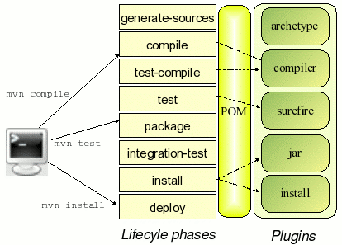
Maven - Build lifecycle Cont…
Build lifecycle is a list of named phases that can be used to give order to goal execution.

Slide 13
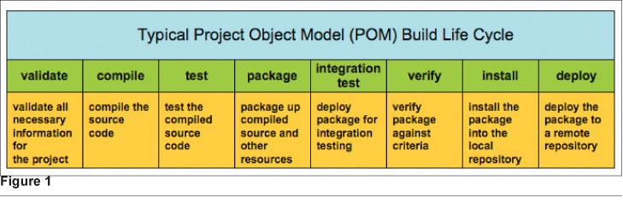
Maven - Build lifecycle
Maven has the following three standard lifecycles −
clean
default(or build)
site

Slide 14
Goals:
Clean
- deletes the target directory and any generated resourses
Compile
- compiles all source code, generates any files, copies resources to our classes directory.
package
- Runs the compile command first, runs any tests, packages the app based off its packaging type.
install
- Runs the package command and then installs it in local repo
deploy
- Runs the install command and then deploys it to a corporate repo

Slide 15
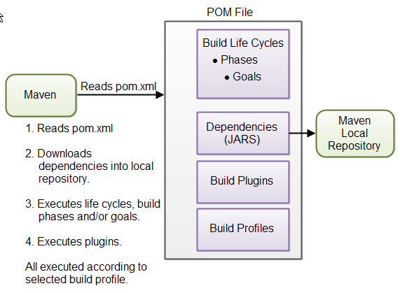
Maven - Overview

Slide 16
POM

Slide 17
POM - Basic Cont…
This is generally unique amongst an organization or a project.
<!-- The Basics --> <groupId>...</groupId> <artifactId>...</artifactId> <version>...</version> <packaging>...</packaging> <dependencies>...</dependencies> <parent>...</parent> <dependencyManagement>... </dependencyManagement> <modules>...</modules> <properties>...</properties>
The artifactId is generally the name of the project
Along with the groupId, It is used within an artifact's repository to separate versions from each other.

Slide 18
POM – Dependeny Management Cont…
<dependencyManagement> <dependencies> <dependency> <groupId>org.glassfish.jersey</groupId> <artifactId>jersey-bom</artifactId> <version>${jersey.version}</version> <type>pom</type> <scope>import</scope> </dependency> </dependencies> </dependencyManagement>
The dependency management section is a mechanism for centralizing dependency information.
When a set of projects inherits a common parent it's possible to put all information about the dependency in the common POM and have simpler references to the artifacts in the child POMs.
Notes:
Using the dependencyManagement element in a pom.xml allows you to reference a dependency in a child project without having to explicitly list the version. Maven will walk up the parent-child hierarchy until it finds a project with a dependencyManagement element, it will then use the version specified in this dependencyManagementelement.

Slide 19
POM – Dependency Management
<dependency> <groupId>org.glassfish.jersey</groupId> <artifactId>jersey-bom</artifactId> <version>${jersey.version}</version> <type>pom</type> <scope>import</scope> </dependency>
${jersey.version} is a placeholder, configure its actual value in <properties> block
<properties> <project.build.sourceEncoding>UTF-8</project.build.sourceEncoding> <jersey.version>2.25</jersey.version> <build.number>SNAPSHOT</build.number> </properties>

Slide 20
POM - Dependencies
<dependencies> <dependency> <groupId>org.glassfish.jersey.containers</groupId> <artifactId>jersey-container-servlet-core</artifactId> </dependency> <dependency> <groupId>org.glassfish.jersey.media</groupId> <artifactId>jersey-media-json-jackson</artifactId> </dependency> </dependencies>

Slide 21
Maven Plugins Cont…
Maven is a plugin execution framework
Build plugins will be executed during the build and it should be configured in the <build/> element from the POM.
Reporting plugins will be executed during the site generation and it should be configured in the <reporting/> element from the POM.
Note: All plugins should have minimal required informations: groupId, artifactId,version.

Slide 22
Maven Plugins Cont…
Maven Plugins are generally used to −
create jar file
create war file
compile code files
unit testing of code
create project documentation
create project reports
Notes:
Core Plugins: Plugins corresponding to default core phases (ie. clean, compile).
Packaging types/tools: These plugins relate to packaging respective artifact types(eg: jar,war)
Reporting plugins: Plugins which generate reports, are configured as reports in the POM and run under the site generation lifecycle(eg:checkstyle, sure-fire report).

Slide 23
Maven - Plugins
<build> <pluginManagement> <plugins> <plugin> <groupId>org.apache.maven.plugins</groupId> <artifactId>maven-compiler-plugin</artifactId> <version>3.5.1</version> </plugin> <plugin> <groupId>org.apache.maven.plugins</groupId> <artifactId>maven-checkstyle-plugin</artifactId> <version>2.17</version> </plugin> </plugins> </pluginManagement> </build>

Slide 24
Sample Application

Slide 25
Sample Application 1 Cont…
Command to set path for Maven
Set java path in JAVA_HOME
Set java path in MAVEN_HOME
Set java path in M2_HOME
Set the class path

Slide 26
Sample Application 1 Cont…
Steps to create the application:
1. Create a Java project
2. Convert the Java project into Maven project
Right click the project -> Configure -> Convert to Maven Project
3. Finish
4.Create a Java class with a simple print statement

Slide 27
Sample Application 1
Steps to Execute the application:
1. $ mvn install
2. $ mvn clean
3. $ mvn compile
4. $ mvn package
5. $ mvn exec:java -Dexec.mainClass="com.hexa.Sample.Welcome"

Slide 28
Standard Project Structure Cont…
To create the standard project structure:
mvn archetype:generate
This creates src/main/java directory which contains the project source code, the src/test/java directory contains the test source, and the pom.xml file is the project's Project Object Model, or POM.

Slide 29
Standard Project Structure
my-app
|-- pom.xml
`-- src
|-- main
| `-- java
| `-- com
| `-- mycompany
| `-- app
| `-- App.java
`-- test
`-- java
`-- com
`-- mycompany
`-- app
`-- AppTest.java

Slide 30
Sample Application 2 Cont…
Steps to create application:
STEP 1:
-mvn archetype:generate
STEP 2:
-Search for “Sample Maven Project”
Choose a number or apply filter (format: [groupId:]artifactId, case sensitive contains): 1055: 1055
Choose org.apache.maven.archetypes:maven-archetype-quickstart version:6
Define value for property 'groupId': com.Hexa

Slide 31
Sample Application 2 Cont…
Define value for property 'artifactId': Maven-Sample
Define value for property 'version' 1.0-SNAPSHOT: : 1.0-SNAPSHOT
Define value for property 'package' com.Hexa: : com.Hexa.Testing
Confirm properties configuration:
groupId: com.Hexa
artifactId: Maven-Sample
version: 1.0-SNAPSHOT
package: com.Hexa.Testing
Y: : Y

Slide 32
Sample Application 2 Cont…
STEP 3:
Open the project from the workspace
STEP 4:
Create a test method in the AppTest.java
STEP 5:
Add dependencies in the POM.XML
STEP 6:
Execute the application using Maven commands.

Slide 33
Sample Application 2 Cont…
Sample Maven application with Junit testing

